Slide 1
Computer graphics - applications

Slide 2
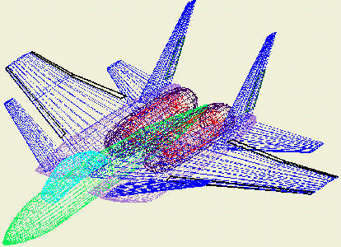
CAD (computer-aided design)
Mostly for engineering and architectural systems
Usually wireframe design, as filling in surfaces takes a lot of time and memory

Slide 3
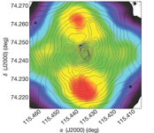
Data visualization
Presenting numerical data in graphical form can often reveal patterns
Here, a 2D plot of brightness patterns observed in the Whirlpool Nebula reveals two distinct galaxies

Slide 4
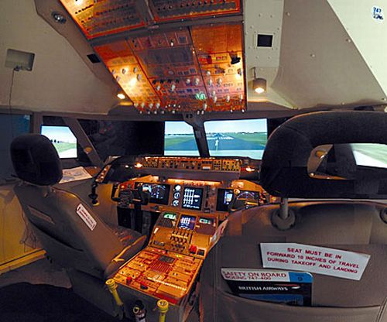
Training, especially simulation

Slide 5
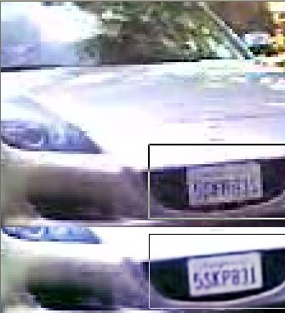
Image processing
Contrast can be enhanced to bring images into clearer focus

